Slide 1
BFS AND DFS

Slide 2
Depth-first Search
Depth-first search is a recursive algorithm for traversing a tree or graph data structure.
It is called the depth-first search because it starts from the root node and follows each path to its greatest depth node before moving to the next path.
DFS uses a stack data structure for its implementation.
The process of the DFS algorithm is similar to the BFS algorithm.
Backtracking is an algorithm technique for finding all possible solutions using recursion

Slide 3
Advantage:
DFS requires very less memory as it only needs to store a stack of the nodes on the path from root node to the current node.
It takes less time to reach to the goal node than BFS algorithm (if it traverses in the right path).
Disadvantage:
There is the possibility that many states keep re-occurring, and there is no guarantee of finding the solution.
DFS algorithm goes for deep down searching and sometime it may go to the infinite loop.

Slide 4
Example:
In the below search tree, we have shown the flow of depth-first search, and it will follow the order as:
Root node--->Left node ----> right node.
It will start searching from root node S, and traverse A, then B, then D and E, after traversing E, it will backtrack the tree as E has no other successor and still goal node is not found. After backtracking it will traverse node C and then G, and here it will terminate as it found goal node.

Slide 5
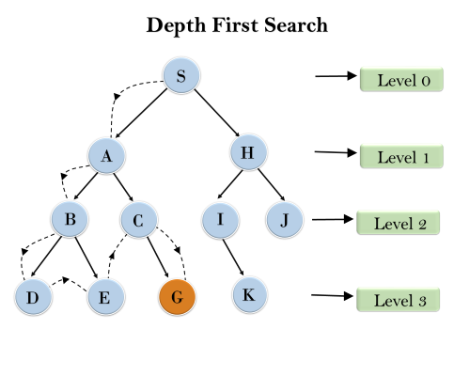

Slide 6
Completeness: DFS search algorithm is complete within finite state space as it will expand every node within a limited search tree.
Time Complexity: Time complexity of DFS will be equivalent to the node traversed by the algorithm. It is given by:
T(n)= 1+ n²+ n³ +.........+ n^{m}=O(n^{m})
Where, m= maximum depth of any node and this can be much larger than d (Shallowest solution depth)

Slide 7
Space Complexity: DFS algorithm needs to store only single path from the root node, hence space complexity of DFS is equivalent to the size of the fringe set, which is O(bm).
Optimal: DFS search algorithm is non-optimal, as it may generate a large number of steps or high cost to reach to the goal node.

Slide 8
Hill Climbing Algorithm
Hill climbing algorithm is a local search algorithm which continuously moves in the direction of increasing elevation/value to find the peak of the mountain or best solution to the problem. It terminates when it reaches a peak value where no neighbor has a higher value.
It is also called greedy local search as it only looks to its good immediate neighbor state and not beyond that.

